Slide 1
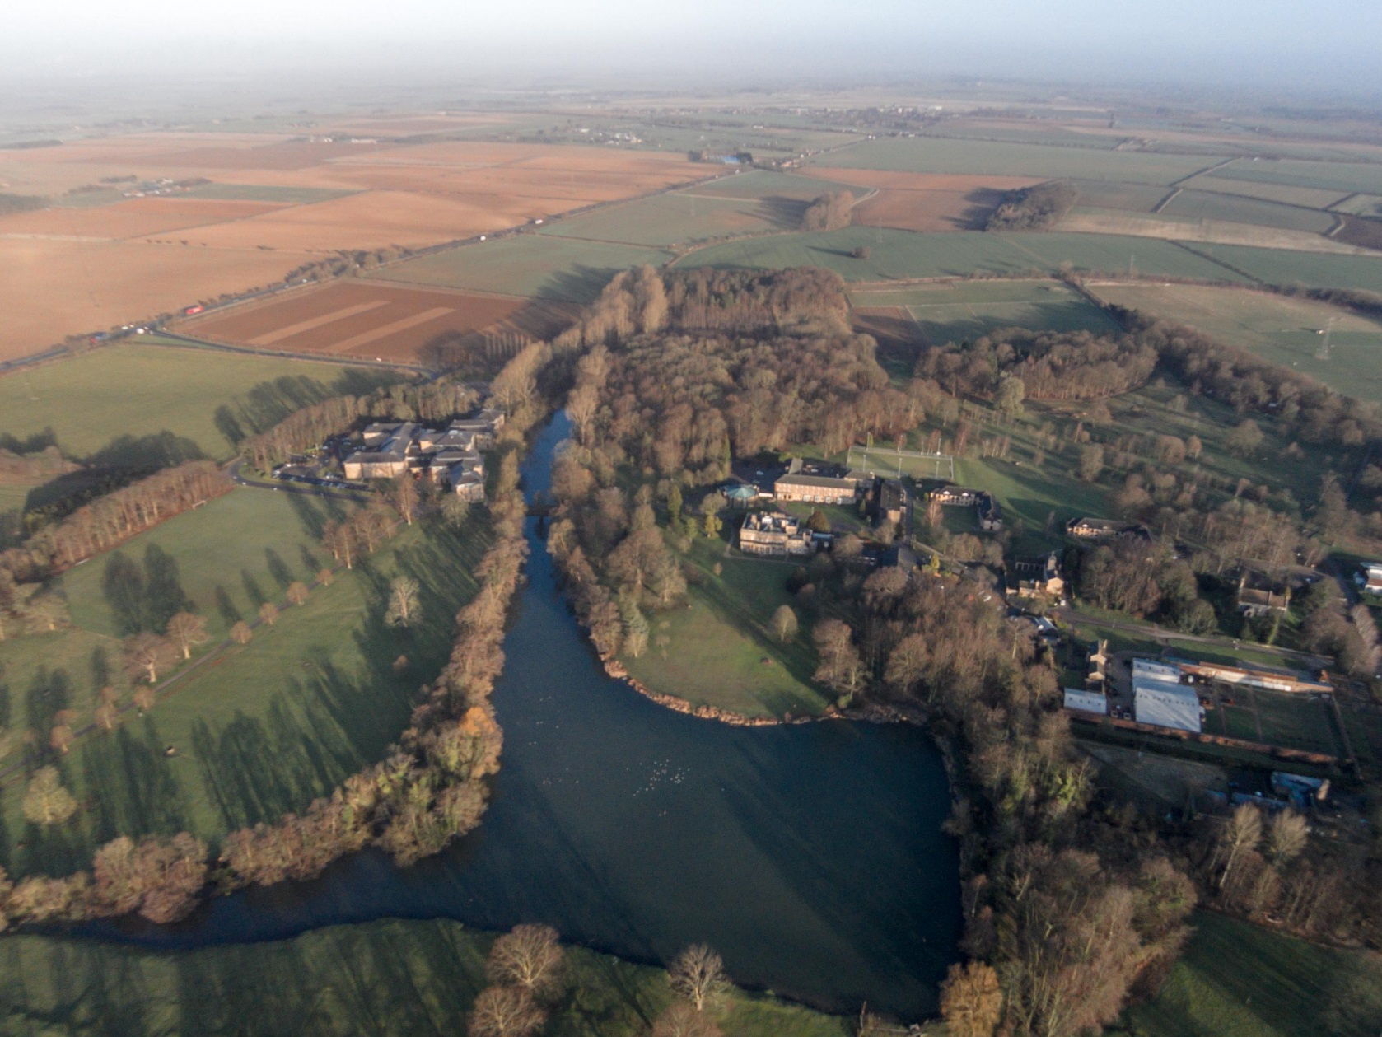
LIAT and water research
David Hutchinson (EA)
Notes:
Going to canter through some of the water research activities we have at the University. The title is research with LIAT but actually I will start with some work that Endwad Hanna and coleagues in he School of Geographty have been doing.

Slide 2
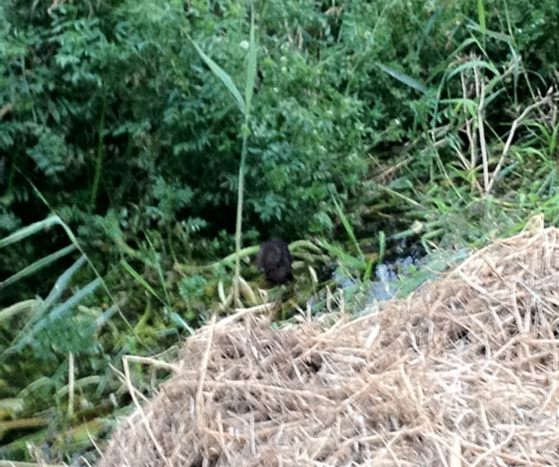
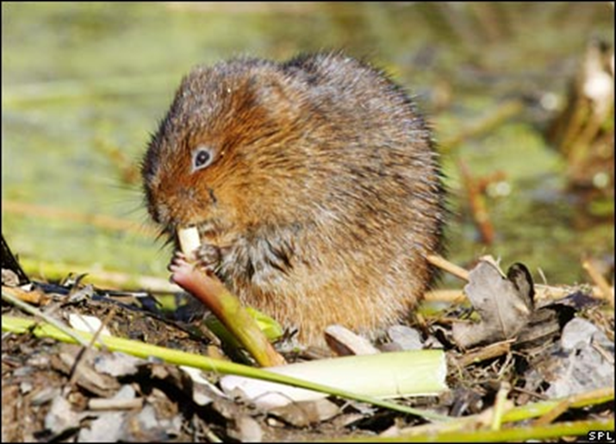


Slide 3
Water for Growth Water Management Plan 2015 – 2040
Average 613mm rain per year.
Current climate models predict a change in rainfall pattern.
The risk of coastal and river flooding affects up to 45% of the GGLEP land area.
Surface water flooding, although of more localised, occurs more frequently and is more difficult to predict.
We need to plan to make changes
Notes:
The Lincs LEP consider management of food and also management of water resources to be critical factors for enabling economic growth of the area.
613mm average rainfall in Lincoln – less than Nairobi and Miami, about the same as Cape Town – places we regard as fairly dry. Cambs, East Anglia and the Humber are faced by similar challenges. UK average is 885..
Around 45% (2,843km²) of Greater Lincolnshire lies within the floodplain - representing 17% of England’s total floodplain area - and has been affected by a number of significant coastal and inland floods, most notably in 1953, 2007, 2012 and 2013.
We have a population of 1,060,000
The Greater Lincolnshire LEP has developed an ambitious plan to increase the value of the local economy by £3.2bn by 2030. (last economic plan current figures 18.3billion). These ambitious plans include 200,000 new houses – than is a lot more consumption or water and also more businesses and jobs that may involve using water. Key areas are agri-food, tourism and manufacturing and engineering -
Greater Lincolnshire is one of the driest regions of the country, and current models of climate change predict increasing scarcity of water over the 21st century. Current models also predict that whilst winter rainfall will increase, by possibly 15-20%, summer rainfall levels will fall by a similar amount. The historic reliance on summer abstraction from surface and groundwater will therefore be less sustainable in the future. Furthermore, climate models predict that we will see more frequent and longer periods of drought or flooding. In the case of drought, the increased frequency of multi-year periods of below average rainfall is particularly difficult to respond to and will necessitate more investment in water storage for both domestic and commercial use.

Slide 4
Water for Growth Water Management Plan 2015 – 2040
Produces and processes over 12% of the UK’s food supply, 25% of its vegetables and 70% of seafood.
Agri-food sector employs over 75,000 people.
Vision to double agri-food sector's contribution by 2030.
The agri-food sector is dependent on water at the right time, in the right quantity and quality.
Notes:
GREATER LINCOLNSHIRE HAS MORE GRADE 1 AGRICULTURAL LAND THAN ANY OTHER LEP IN ENGLAND
Greater Lincolnshire has more grade 1 agricultural land than any other LEP in England, producing and processing over 12% of the UK’s food supply, including more than 70% of its seafood and 25% of its vegetables. The sector employs more than 75,000 people across the supply chain,
The Greater Lincolnshire Agri-food Sector Plan’s vision is to double the sector’s economic contribution by 2030 with a focus on high value manufacturing, increasing the production of intensive crops and livestock (eg, poultry) and investment in new areas such as aquaculture. All of these areas of growth will require additional water provision and improved water management

Slide 5
Defra 25 year Environment Plan
‘Its goals are simple: cleaner air and water; plants and animals which are thriving; and a cleaner, greener country .’for us all
Sustainable Abstraction
Better water quality for drinking and biodiversity
Sustainable personal use
Fewer leaks
Restoring habitats

Slide 6
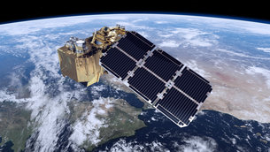
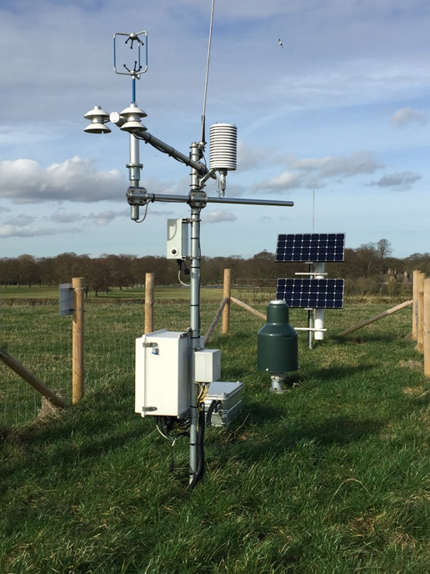
Water Measurement
Sentinel
Cosmos
Notes:
Working with the CEH and Chinese Met office
COSMOS sentinel
Economic 70% fresh ater world wide is
50% food demand increase water a majotr constraint, Some parts at 95%
Water footprint tomatoes
If we can
We use 3.4 tones water/person /day to produce UK just on food Of which 2 tons is comin from somewhere else outside uk (62%)

Slide 7
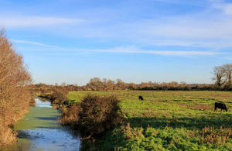
New Farming Rules for Water
Come into force April 2018
8 rules, most farmers already comply, especially in an NVZ area.
Include rules for fertiliser and manure planning, storage and application, soil erosion, poaching by livestock and location of livestock feeders.
gov.uk/government/news/new-farming-rules-for-water
Overall, farming is now the most significant source of water pollution and of ammonia emissions into the atmosphere in the UK. It accounts for 25% phosphate, 50% nitrate and 75% sediment loadings in the water environment
Notes:
Include planning use of fert and manures- soil testing at least every 5 years and taking into account conditions including soil testing for N
Storing animal manures away from water
No spread zone for manures
No spread zone fert
Spreading conditions manures
Minimise erosion
No livestock erosion with 5m water course by poaching
No livestock feeders close to water

Slide 8


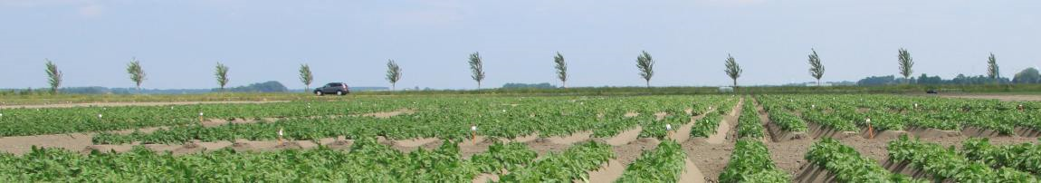



Slide 9
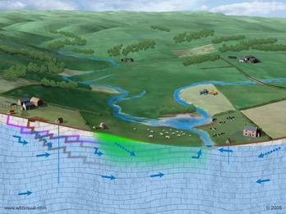
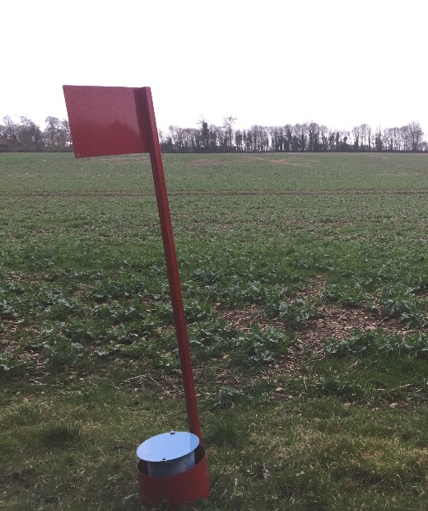
Water resources, flood and drought
Notes:
Boreholes – we can look at aquifers – water quality and recharge
Economic 70% fresh water world wide is used for food production. In some parts of the world 95% of freshwater
50% food demand increase water a majotr constraint, Some parts at 95%
Water footprint tomatoes
If we can
We use 3.4 tons water/person /day to produce UK just on food Of which 2 tons is coming from somewhere else outside uk (62%)

Slide 11
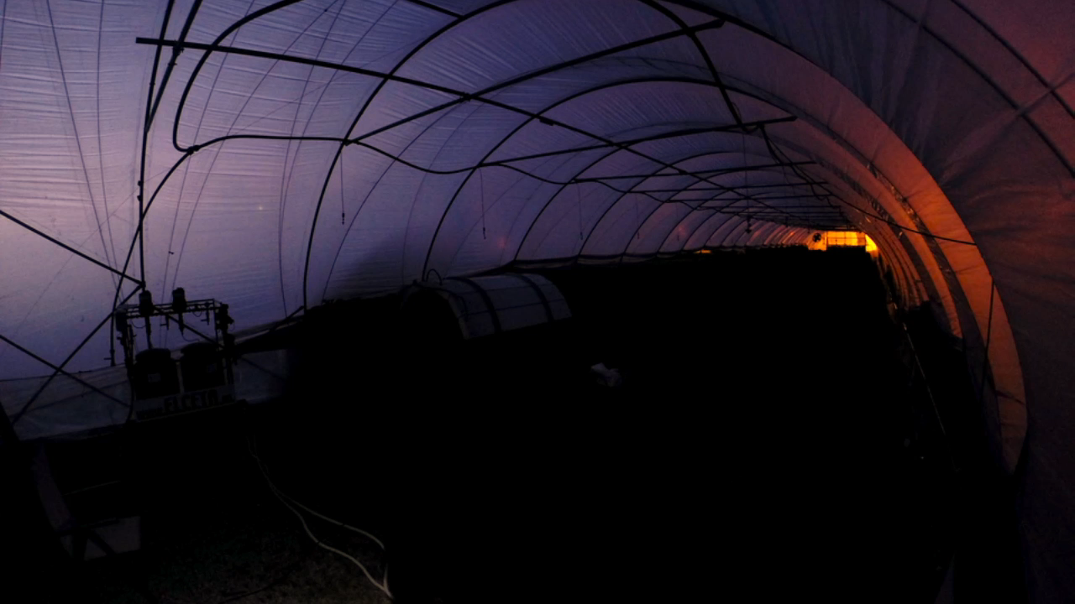
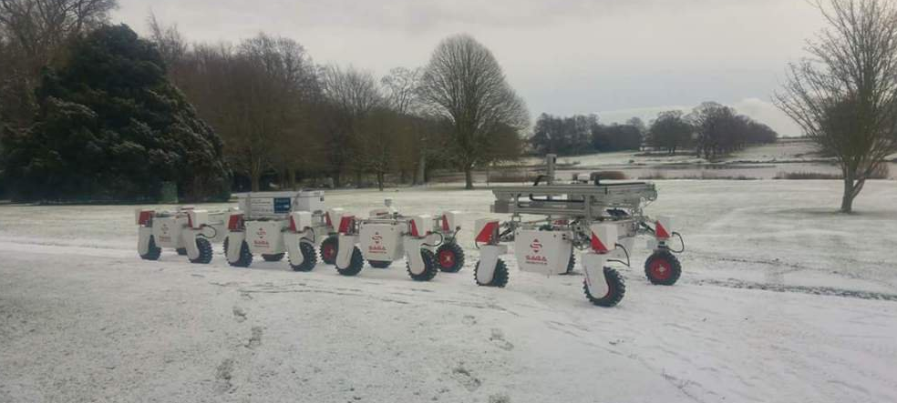
Reduction in pesticide use
Notes:
Trials have shown how the agricultural robot can be used to direct an extremely low intensity ultra-violet light onto strawberries to zap mildew as it travels along rows, and the scientists are currently testing methods to perfect this procedure in order to combat fungal infections without the use of pesticides.
Ultra-violet, or UV, light is electromagnetic radiation with wavelengths between the visible spectrum (400 nanometres) and x-rays (4–20 nanometres). UV light is subdivided into three groups depending on the wavelength. In Thorvald's treatment of strawberry plants UV-B light is used (280–315 nm).
Energy from UV light can destroy microorganisms such as mould by breaking down chemical bonding in the DNA so that the cells die. This technique is frequently used to get rid of fungal growth in homes after flooding, or to rescue books or museum artefacts which have been attacked by mould.
Infitration rate, flooding drought

Slide 12




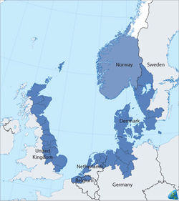









De Zilte Smaak, Teschelling

Slide 13
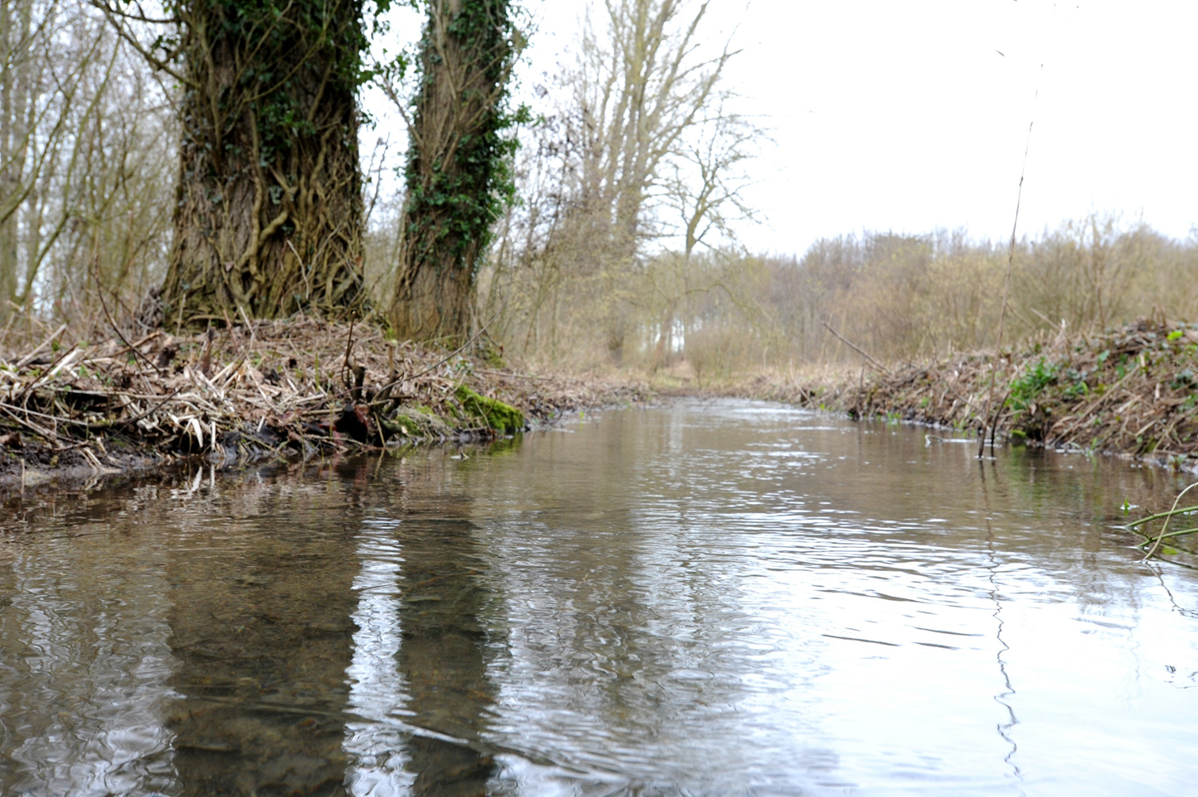
Natural Flood Management

Slide 14
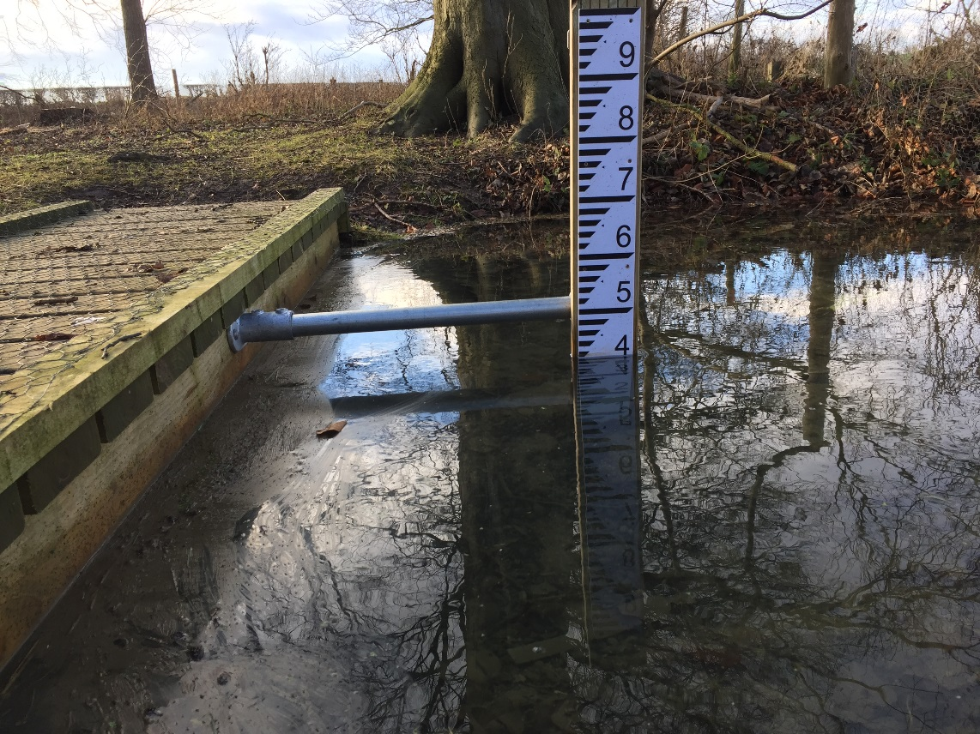
Natural Flood Management

Slide 15
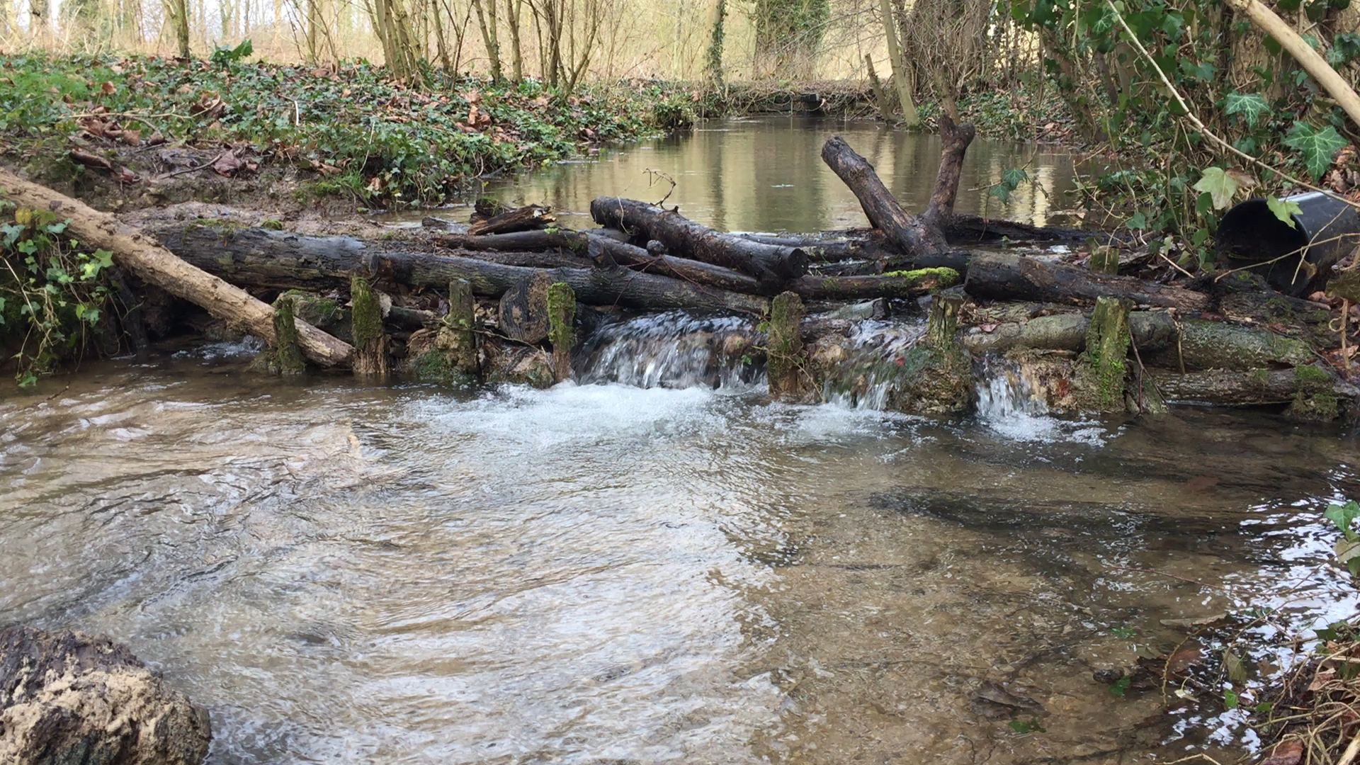

Notes:
Sediment trapping and flood attenuation
Local demonstration to stakeholders such as farmers

Slide 16
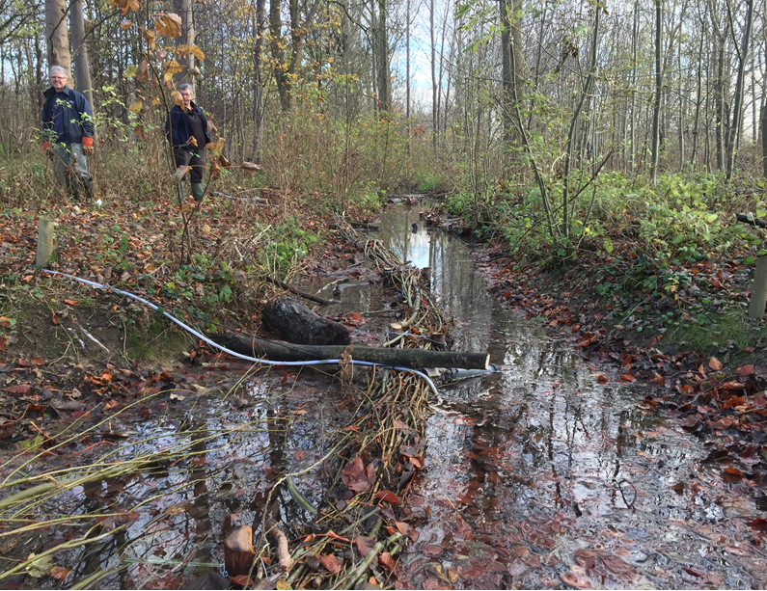

Slide 17
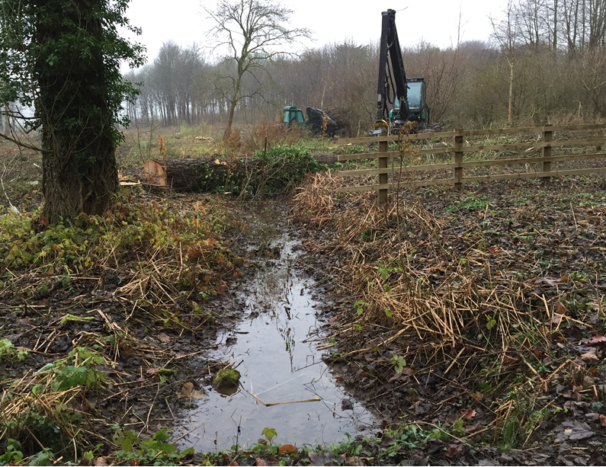

Slide 18
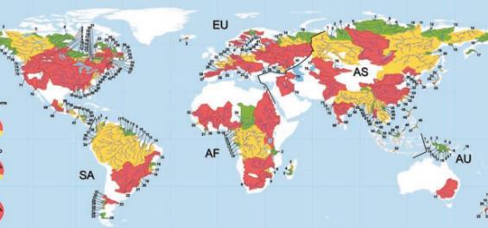
Lincoln Centre for Water and Planetary Health
Flood and the ‘World’s Largest Rivers’.
Water, malaria hotspots and earth observation.
.
Notes:
Focusing on solving thr most pressing environmental an societal problems emerging from the Worlds Largest Rivers (21 in total, from 100s large rivers – in map above) Some pass through multiple countries – a challenge.
Some of the worlds largest cities are on the WLRs including Karachi, Kolkata and Shanghai.
Challenges that need resolving include extreme drought, flood, flood related contamination from metal mining and processing, water- borne and vector-borne diseases.
Prof Mark Macklin shares a professorship in NZ which means we can widen our access to ideas, research etc
Flood Mal – using the current water and flood models and vector (mosquito) models in Zambia combined with the newly available earth observation data to better forecast malaria hotspots in order to locate areas and provide appropriate intervention.
In December 2013, the east of England experienced the most severe tidal surge since the 1953 flood, with sea levels rising by almost six metres in places. More than 2,000 acres of farmland was flooded with some of the most serious breaches south of the Humber and around Boston.
The new study aims to work out the true economic cost of coastal flooding and how farmland damaged by saltwater can best be brought back into use to support Lincolnshire’s agricultural industry.
The study is delivered in collaboration with farmers operating in and around the Lincolnshire Wash.
The team of scientists and economists will consider the potential economic impact including the long-term effects of increased levels of soil salinity on agricultural land.
This will include modelling future scenarios of potential sea level rises and resulting impact on soil salinity levels on England’s east coast. 40% of lincs prine to flooding. This project darws on Dutch and other expertise. (just as as the Dutch drained it the first time.. We really need those partnerships

Slide 19
What else?
We have completed some work looking at the effect of cover crops on nitrate leaching.
We are studying field drainage
We are embarking on some studies on the effects of trees
We want to be more ambitious with the Cringle Brook ideas
Boreholes
Pesticide handling facilities

Slide 20
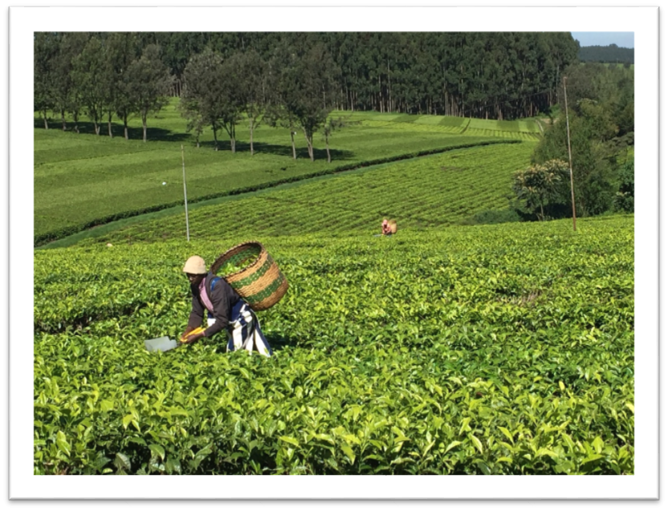

Food Security may be related to water
Notes:
Water of course links to food security
Lins to water in Spanish tomatoes story

Slide 21
To summarise
We have a rapid growth in water related activities from global to field scale.
We thrive on developing strong partnerships with business organisations and getting involved in real world planning and practical applied solutions.
We are keen to use our science and business base to help work on projects that make a difference.
Thank you
Isobel Wright and the LIAT team
Notes:
I hope that I have hown you
If you would like to talk to anyone in LIAT – Simon, Iain Gould Emma Seamer and I

